Slide 1
Working Loads and Design Factors in Rigging
Things to do to assure safe outcomes

Slide 2
Working Loads and Design Factors
Although most of our work in rigging is focused on counterweight systems, there are times when we need to hang something besides stage curtains or lights.
These include lighting fixtures (chandeliers), set pieces, portals, and projection surfaces.

Slide 3
Working Loads and Design Factors
We can do this work in a variety of ways, however there are procedures that will ensure our work is reliable, predictable and safe.

Slide 4
As we look at this, there are two important things you need to know.
1. How much does the element weigh?
2. Will it move?

Slide 5
Working Loads and Design Factors
Knowing the weight will help you determine the required strength of the hardware to be used.
Whether the object moves will influence our design decisions.

Slide 6
Working Loads and Design Factors
To begin, we will need to know the working load limits for some of the standard hardware used in theatre rigging. Let’s start with wire rope.

Slide 7
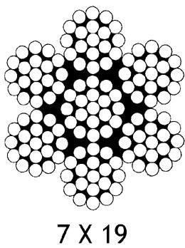
Working Loads and Design Factors
7x19 Galvanized Aircraft Cable (GAC) is the most commonly used wire rope. Available diameters range from 1/8” to ½”. Let’s look at 1/8”.

Slide 8
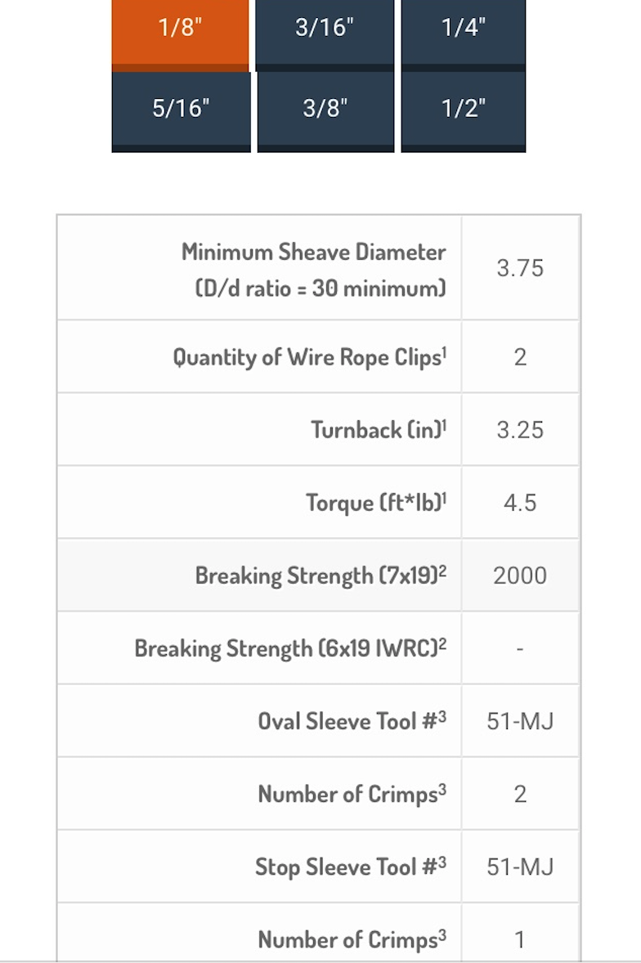
Working Loads and Design Factors
Breaking Strength 2000lbs.

Slide 9
Working Loads and Design Factors
To terminate the wire rope, we will likely use one of two methods. The most common is with wire rope clips and the second, uses a swaged compression fitting.

Slide 10
Working Loads and Design Factors
Number of wire rope clips.

Slide 11
What we know (and how we can apply the information)
1/8” GAC has a breaking strength of 2000lbs.
Wire Rope Clips, when applied correctly, have an efficiency of 80%. We will discuss application procedures in another video.
We also need to apply a Design Factor.

Slide 12
What is the design factor?
A ratio of load to breaking strength. A verifiable measurement to ensure that we are within the safe use range for the rigged element. It is also known as “safety factor”.
The two most common design factors are:
5:1 for static/unmoving elements
8:1 for elements that move
Using our 1/8” GAC, we know it has a breaking strength of 2000lbs. Applying a 5:1 design factor reduces that strength to 400lbs. (2000/5 = 400)

Slide 13
How do you apply an efficiency percentage?
The efficiency assigned to a method of termination has been determined through testing of that termination under load.
After we apply a design factor of 5 for our wire rope, we will then apply our efficiency percentage. This is called de-rating.
5:1 design factor is 400lbs. (2000/5 = 400)
400 * 80% (400 * 0.8) = 320lbs.
Using these calculations, you are no longer guessing about the safety and efficiency of your rigging, you know it can do the job.

Slide 14
Let’s do some calculations…
We need to hang a 300lbs. chandelier that will be flown in twice during the show. Our plan calls for using 1/8” GAC and wire rope clips.
What is our design factor?
8:1
What is the calculated breaking strength?
250lbs.

Slide 15
Let’s do some calculations…
Can we use 1/8” GAC?
No
What then are some solutions?
Likely, the easiest solution is increasing the size of the GAC to 3/16” with a breaking strength of 4200lbs.

Slide 16
Let’s do some calculations…
Our new calculations are:
4200/8 = 525lbs.
De-rating for the wire rope clips:
525 * 0.8 = 420lbs.

Slide 17
What you know and what you can do with that knowledge
We now understand how to prepare to rig an object/scenic element.
We know that we need to calculate for the Design Factor
We need to de-rate for our termination’s efficiency
With this information, we can rig with greater confidence and not just hope that our work is safe.

